Slide 1

Vanguard FTSE Europe ETF (VGK)
Group name: Group 3

Slide 2
General, relevant market information
European equities ETF investing in developed European markets.
Market influenced by ECB monetary policies, European economic growth, political stability within the EU, consumer behavior, unemployment rates, and inflation dynamics.

Slide 3
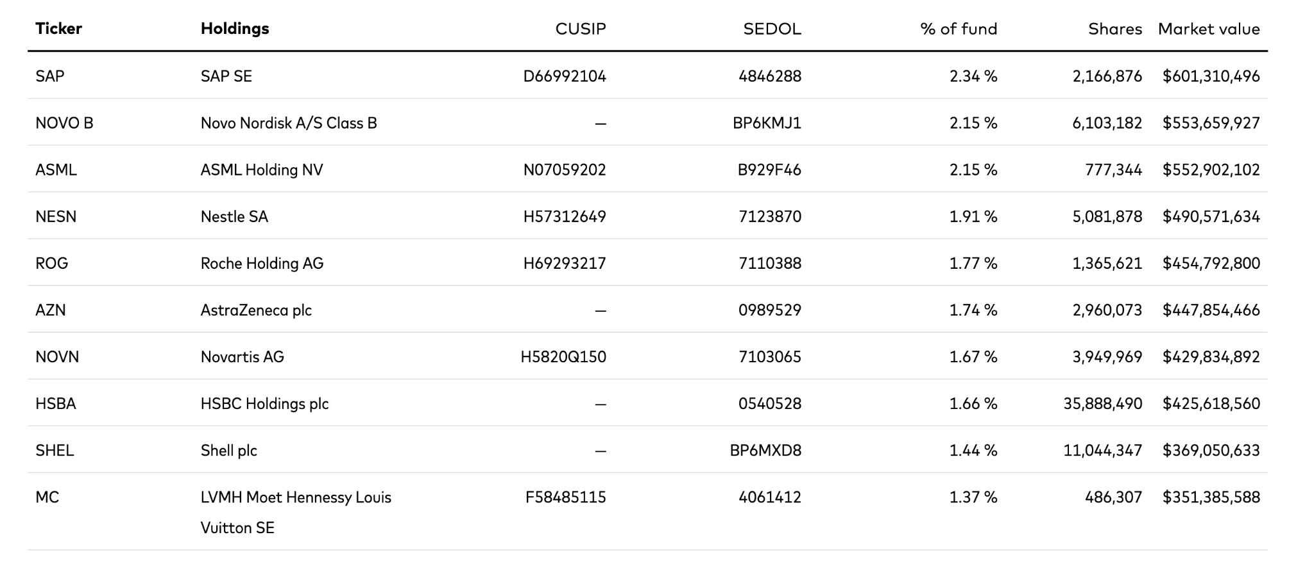
General, relevant market information

Slide 4
Business overview
Company Background: VGK tracks FTSE Developed Europe All Cap Index; includes large-cap and mid-cap European stocks.
Revenue Sources: Primarily from capital appreciation and dividend income from underlying European stocks.
Customers: Institutional and retail investors seeking European market exposure.
Business Model: Passive ETF management with low expense ratio (0.08%), offering broad, diversified exposure.
Positive News:
Economic recovery post-pandemic.
Strong dividend yields among European blue-chip companies.
Negative News:
Geopolitical tensions (Ukraine-Russia conflict).
Energy crisis vulnerability.

Slide 5
Business overview
SWOT Analysis:
Strengths: Diversified exposure, low fees.
Weaknesses: Sensitive to European economic instability.
Opportunities: Post-pandemic recovery, undervalued European markets.
Threats: Geopolitical risks, inflation pressures.

Slide 6
Industry Performance
Industry: Diversified European equities.
Growth: Moderate growth post-pandemic, driven by tech, industrials, and consumer sectors.
Market Share: VGK is a leading European ETF (approx. $21B AUM).
Competition: Competitive but VGK maintains a strong position due to cost leadership and liquidity.

Slide 7
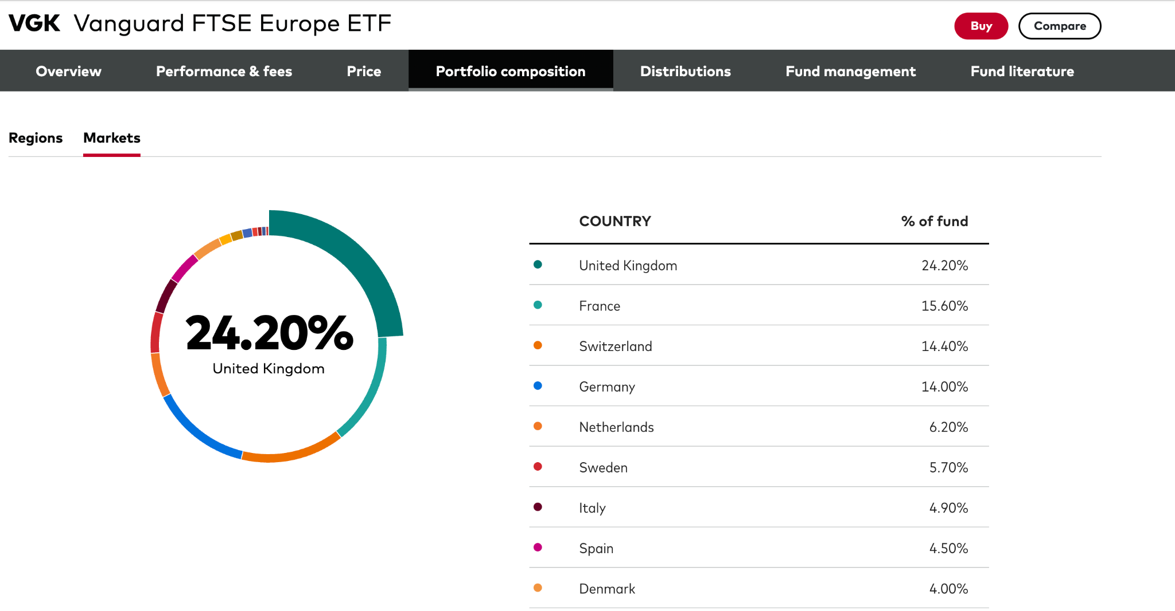
Industry Performance

Slide 8
Fundamentals
Revenue & Earnings Trends: Stable dividend distributions; moderate long-term capital appreciation.
Financial Ratios:
Dividend yield ~3%.
Expense ratio: 0.08% (below industry average).
Debt Management: Not directly applicable; monitors financial health of holdings.
Valuation: Moderately undervalued compared to historical valuations (P/E multiples below historical averages).

Slide 9
Risk
Highly competitive European markets.
Inflation and interest rate exposure.
Geopolitical instability (Ukraine conflict).
Commodity price volatility, especially energy.
Regulatory risks across multiple jurisdictions.

Slide 10
Proposal and Exit strategy
Proposal: Allocate 10% of portfolio to VGK.
Rationale: Attractive valuation, stable dividends, potential recovery in Europe.
Exit Strategy:
Sell if geopolitical tensions escalate significantly.
Trigger stop-loss at ~10% downside.
Reevaluate quarterly based on economic indicators and inflation reports.

Slide 11
Thank you.

